Slide 1
STUDENT HIVE
CS 691 – Computer Science Capstone Project

Slide 2
Agenda
Team Members & Roles
Problem Statement
Project Description
Personas
Technologies & Algorithms
Team Working Agreement
Retrospective

Slide 3
INTRODUCTION

Slide 4
AGENDA
Review progress towards project deadlines and milestones and discuss any delays or challenges encountered and identify solutions.
Ensure alignment on the development progress and tasks completed and address any roadblocks hindering development and strategize solutions.
Brainstorm and study through personas to understand client requirements thoroughly and Identify and prioritize the necessary features and functionalities from the client's perspective.
Discuss potential risks associated with the project and their impact and Strategize mitigation plans to address identified risks effectively.
Recap key discussion points and action items also confirm the date and time for the next meeting, if necessary and ensure open communication and collaboration among team members.

Slide 5
Team Members & Roles

Slide 6




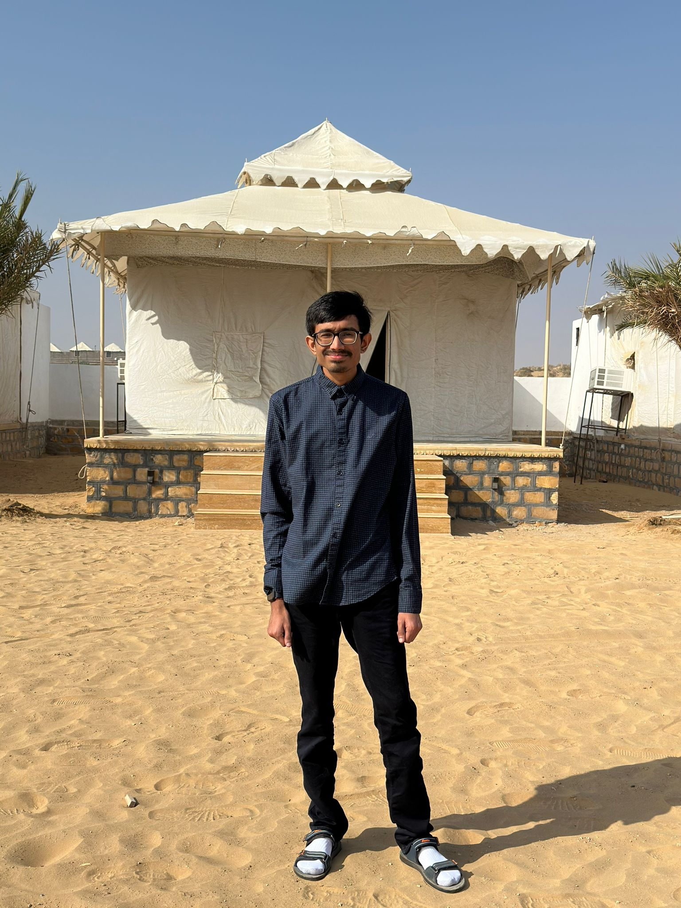


MEET OUR TEAM
SMIT
SUJAN SIDDARTH
KIRAN KUMAR
YASHKUMAR
FRONT END DEVELOPER
TESTER
FULL STACK DEVELOPER
DATABASE ADMINSTRATOR
PARTH
SIDDHARTHKUMAR
RAJ KOUSHIK
PROJECT MANAGER
DATA ANALYST
FULL STACK DEVELOPER

Slide 7
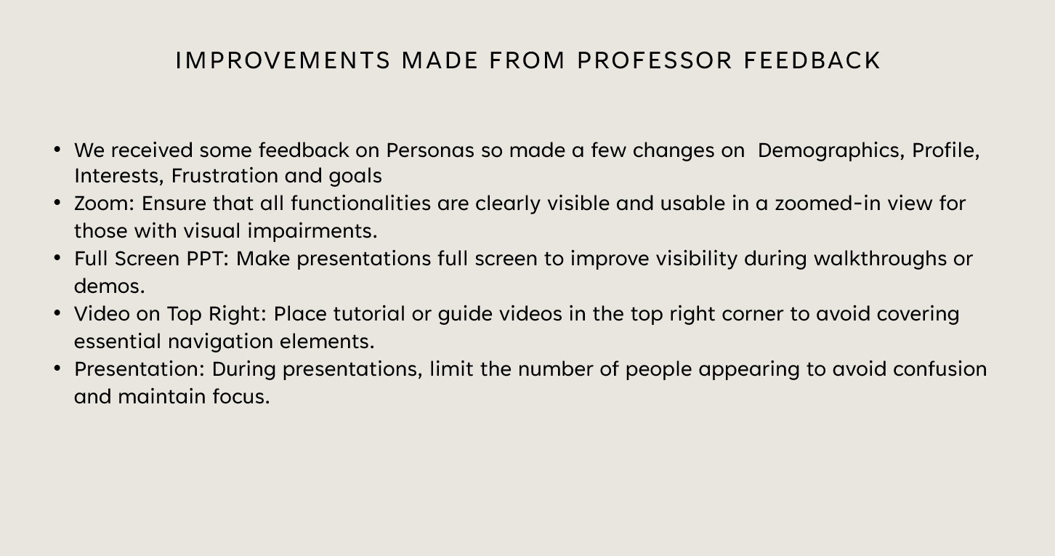
Improvements made from professor feedback
We received some feedback on Personas so made a few changes on Demographics, Profile, Interests, Frustration and goals
Zoom: Ensure that all functionalities are clearly visible and usable in a zoomed-in view for those with visual impairments.
Full Screen PPT: Make presentations full screen to improve visibility during walkthroughs or demos.
Video on Top Right: Place tutorial or guide videos in the top right corner to avoid covering essential navigation elements.
Presentation: During presentations, limit the number of people appearing to avoid confusion and maintain focus.

Slide 8
PROBLEM STATEMENT

Slide 9
PROBLEM STATEMENT
In the current landscape of student housing, there exists a lack of secure and convenient platforms tailored specifically to the needs of students seeking shared living arrangements. Many students struggle to find reliable and trustworthy accommodation options that align with their preferences, leading to frustration and uncertainty in their housing search. Additionally, the absence of comprehensive resources such as transportation information and nearby amenities further complicates the process, leaving students feeling overwhelmed and disconnected from their potential living environments. As a result, there is a pressing need for a solution that addresses these challenges and provides students with a seamless and empowering experience in finding suitable accommodation.

Slide 10
PROJECT DESCRIPTION

Slide 11
PROJECT DESCRIPTION
"Student Hive" is a secure and convenient platform designed for students seeking shared living arrangements. By registering with their school email, users gain access to comprehensive listings tailored to their accommodation preferences and budgeting needs. Advanced search options and communication tools facilitate connections with potential roommates or landlords, while additional resources such as transportation information and nearby amenities enhance the overall living experience. With support and community engagement features available, "Student Hive" empowers students to confidently navigate their search and find the perfect accommodation suited to their needs.

Slide 12
PERSONAS

Slide 13

Persona 1: Hash, Budget-Conscious Student
Profile:
Mechanical Engineering undergraduate from India, pursuing a master's in Mechanical Engineering at New York University. Harsh is focused on his studies and values a quiet and conducive environment for learning. Being a vegetarian, he prefers living with like-minded individuals who respect his dietary choices. Harsh is seeking accommodation within a commutable distance from the university to minimize travel time and expenses.
How Student Hive Can Help:
Student Hive provides a platform for Harsh to search for accommodation listings tailored to his preferences, including private rooms and vegetarian-friendly options. Advanced search filters allow Harsh to narrow down his options based on proximity to New York University and other amenities. The platform's communication tools enable Harsh to connect with potential roommates who share similar dietary preferences and lifestyle choices, facilitating a smoother roommate selection process. Additional resources such as transportation information can help Harsh evaluate the commute options from different accommodation listings to ensure convenience. By leveraging Student Hive, Harsh can confidently navigate his search for accommodation, ultimately finding the perfect living space suited to his needs and preferences as a vegetarian graduate student at New York University.
Challenges:
Limited knowledge of local housing options and rental procedures in New York City. Ensuring compatibility with potential roommates regarding dietary preferences and lifestyle choices. Balancing academic commitments with the demands of finding suitable accommodation in a new city.
Demographics
Name: Harsh Venkata
Age: 21
School: New York University
Goals and Needs:
Find accommodation near New York University that offers a private room.
Ensure the accommodation is suitable for a vegetarian lifestyle.
Prioritize proximity to the university to minimize commute time.
Connect with potential roommates who share similar preferences and values.

Slide 14

Persona 2: Andre, Budget-Conscious Student
Profile:
Andre is a Computer Science Engineering undergraduate from China who is now pursuing a master's degree in Cyber Security Engineering at Pace University. He is outgoing and enjoys socializing with peers, making him eager to find shared accommodation with other Pace University students. Andre values convenience and practicality, preferring accommodation within a commutable distance from the university and close to essential amenities such as groceries. With a budget of around $1000 per month, Andre seeks affordable housing options that still offer desirable features like in-house laundry and a parking space.
How Student Hive Can Help:
Student Hive offers a platform for Andre to search for shared accommodation listings specifically tailored to Pace University students, increasing the likelihood of finding compatible roommates. Advanced search filters allow Andre to refine his search based on proximity to Pace University, rental price, and amenities such as in-house laundry and parking. The platform's comprehensive listings include information on nearby groceries and other essential amenities, helping Andre assess the convenience of each accommodation option. Andre can communicate directly with potential roommates through the platform's messaging tools, facilitating the roommate selection process and fostering a sense of community. By leveraging Student Hive, Andre can streamline his search for shared accommodation, ultimately finding a living space that meets his needs and preferences as a graduate student at Pace University.
Challenges:
Finding shared accommodation with other Pace University students that meet his specific preferences and budget constraints. Balancing the need for affordability with the desire for desirable features such as in-house laundry and parking. Navigating the rental market in a new city while also managing academic commitments.
Demographics
Name: Andre Lin
Age: 26
School: Pace University
Goals and Needs:
Find shared accommodation with other Pace University students to foster a sense of community and companionship.
Prioritize accommodation options within a commutable distance from Pace University.
Ensure the accommodation is close to groceries and other essential amenities.
Stay within a budget of around $1000 per month for rent.
Prefer accommodation with in-house laundry facilities and a parking space.

Slide 15

Persona 3: Todd, Budget-Conscious Student
Profile:
Todd is a Network Engineering undergraduate from Denver who is now pursuing a master's degree in Network Engineering at New York University. He is proactive and resourceful, eager to leverage his living situation to connect with other students and potentially alleviate some of the financial burdens associated with living in New York City. Todd is looking to post accommodation listings to share his room with other students, aiming to find long-term roommates who can contribute to a positive living environment. He values transparency and wants to provide detailed information about the available rooms, including location, rent, amenities, and photos, allowing potential roommates to make informed decisions. Todd also wants the ability to preview his listing before posting to ensure accuracy and attractiveness.
How Student Hive Can Help:
Student Hive offers a platform for Todd to post detailed accommodation listings, including location, rent, amenities, and photos, to connect with other students seeking accommodation. Todd can use the platform's communication tools to engage with potential roommates, facilitating the roommate selection process and ensuring compatibility. The ability to preview listings before posting allows Todd to make necessary adjustments to ensure accuracy and attractiveness, increasing the likelihood of attracting suitable roommates. By leveraging Student Hive, Todd can efficiently and effectively find long-term roommates who meet his preferences and contribute to a positive living environment during his studies at New York University.
Challenges:
Finding compatible long-term roommates who align with his preferences and values. Ensuring accurate and appealing presentation of the accommodation listings to attract potential roommates. Managing the logistics of coordinating with potential roommates and facilitating the roommate selection process.
Demographics
Name: Todd Gilson
Age: 23
School: New York University
Goals and Needs:
Post accommodation listings to share his room with other students at New York University.
Connect with other students looking for accommodation to find long-term roommates.
Provide detailed information about the available rooms, including location, rent, amenities, and photos.
Preview listings before posting to ensure accuracy and attractiveness.

Slide 16
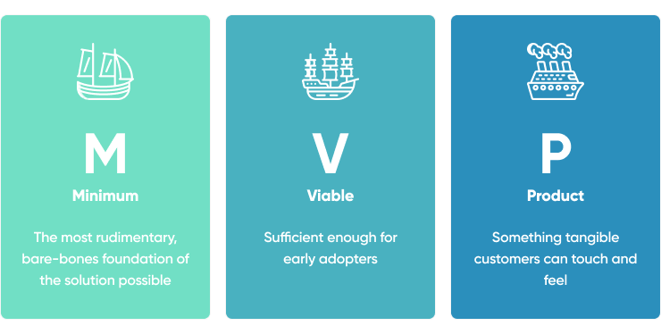

Slide 17
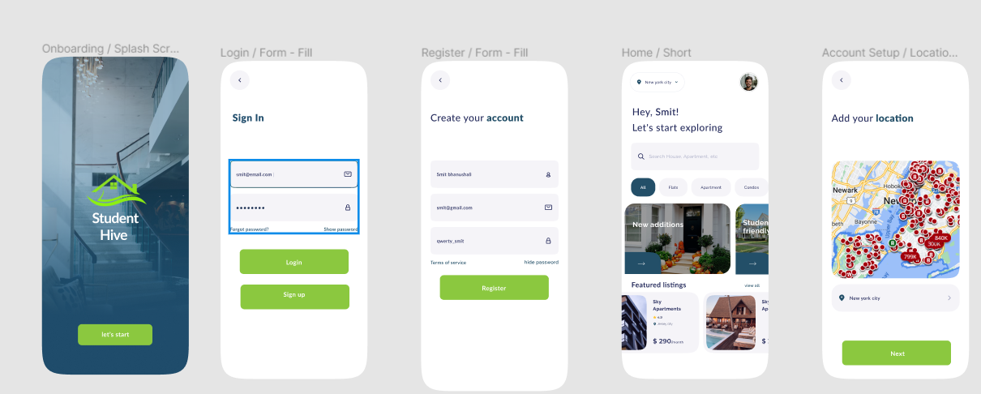

Slide 18
Technologies & Algorithms

Slide 19






TECHNOLOGIES
Front End
React, Oauth2.0, TanStack Query(Context API - State Management), Axios, Zod (Validation)
Back End
Node JS, Fastify, MongoDB, Passport JS(Auth), Mongoose (ORM)
ALGORITHMS
KNN, Linear Regression

Slide 20
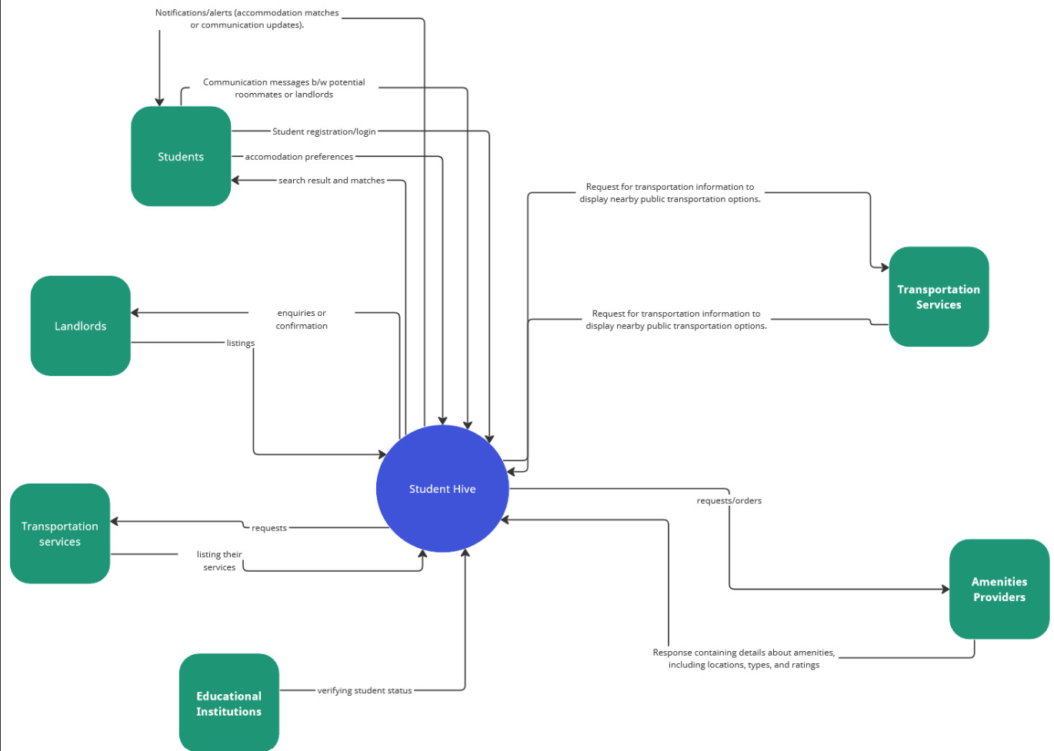
Conceptual diagram

Slide 21
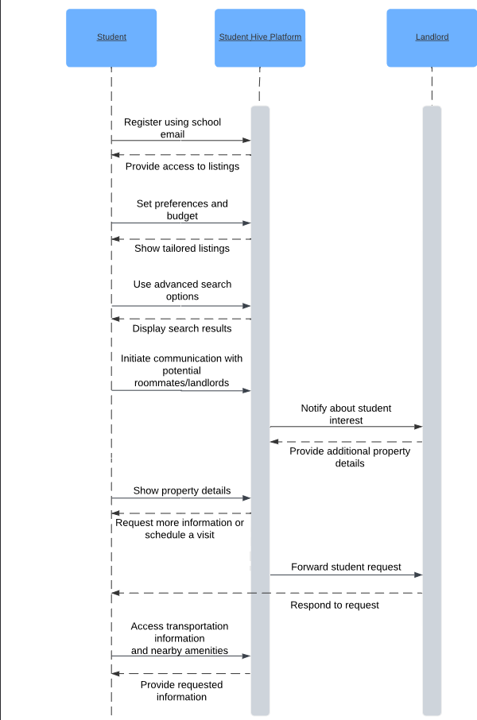
Sequence diagram

Slide 22
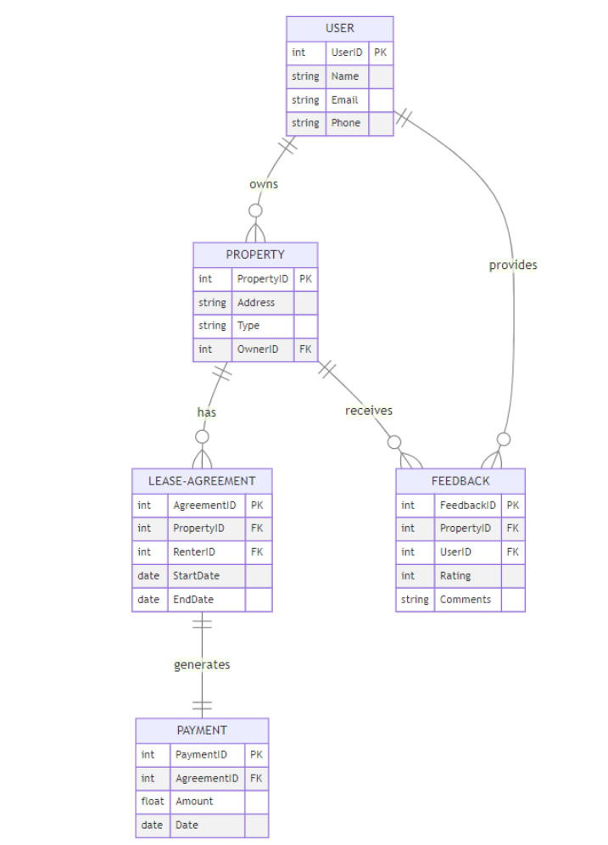
ER diagram

Slide 23
User Stories
As a student I want vegetarian roommates.
As a student I want accommodation with students from NYU.
As a student I want public transport close to the accommodation.
As a student I want groceries near by.
As a student I want a private room.
As a student I want accommodation with flexible lease terms.
As a student I want accommodation with access to high-speed internet.
As a student I want accommodation with study-friendly environments.
As a student I want accommodation with 24/7 security measures.
As a student I want a cheaper accommodation.
As a student I want amenities.
As a student I want to share room with long term roommates.
As a student I want to share accommodation with female roommates.

Slide 24
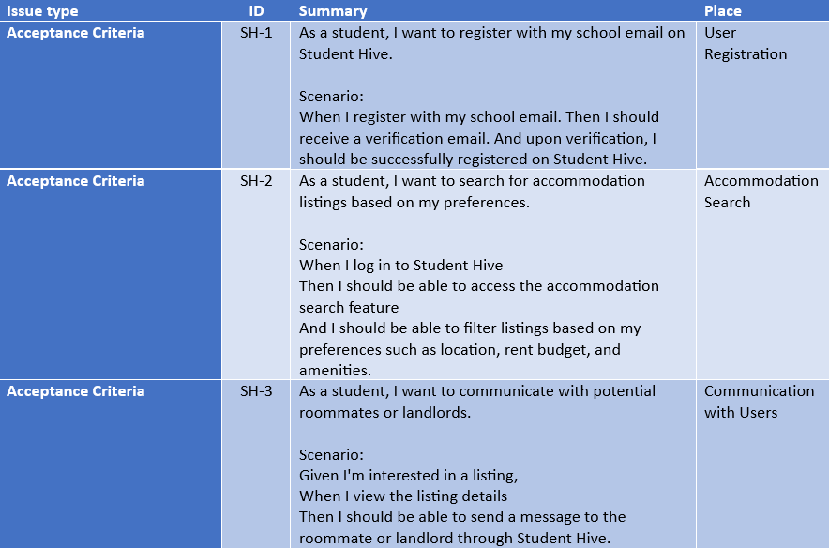
Acceptance Criteria and User Stories

Slide 25
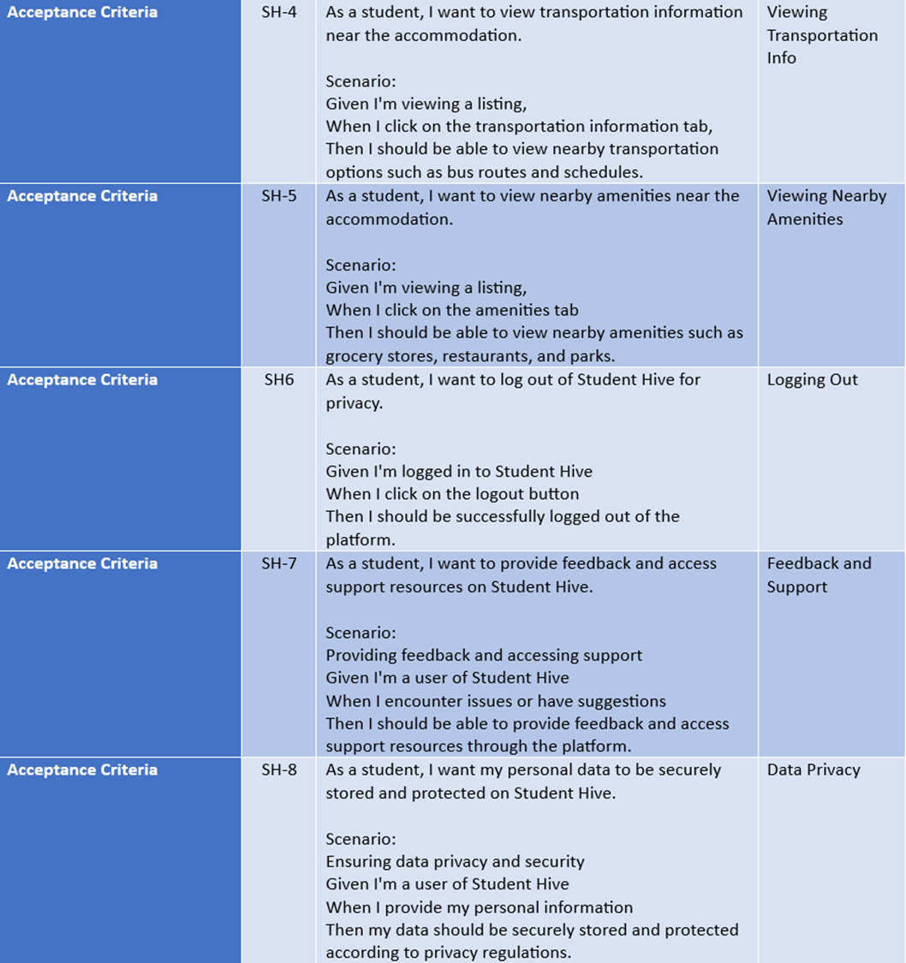

Slide 26

Metrics

Slide 27
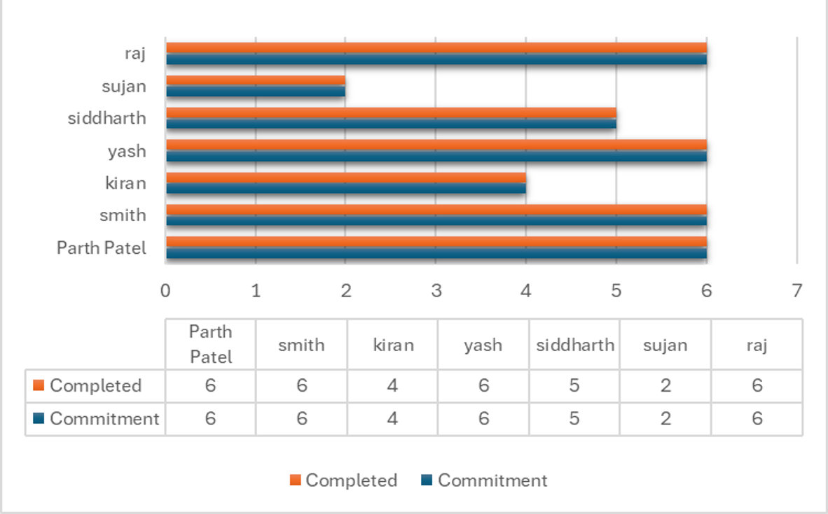
Task Commitment

Slide 28
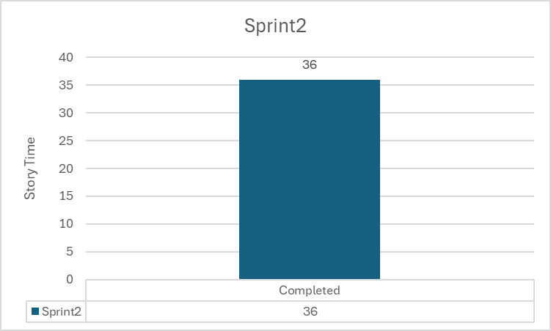

Slide 29
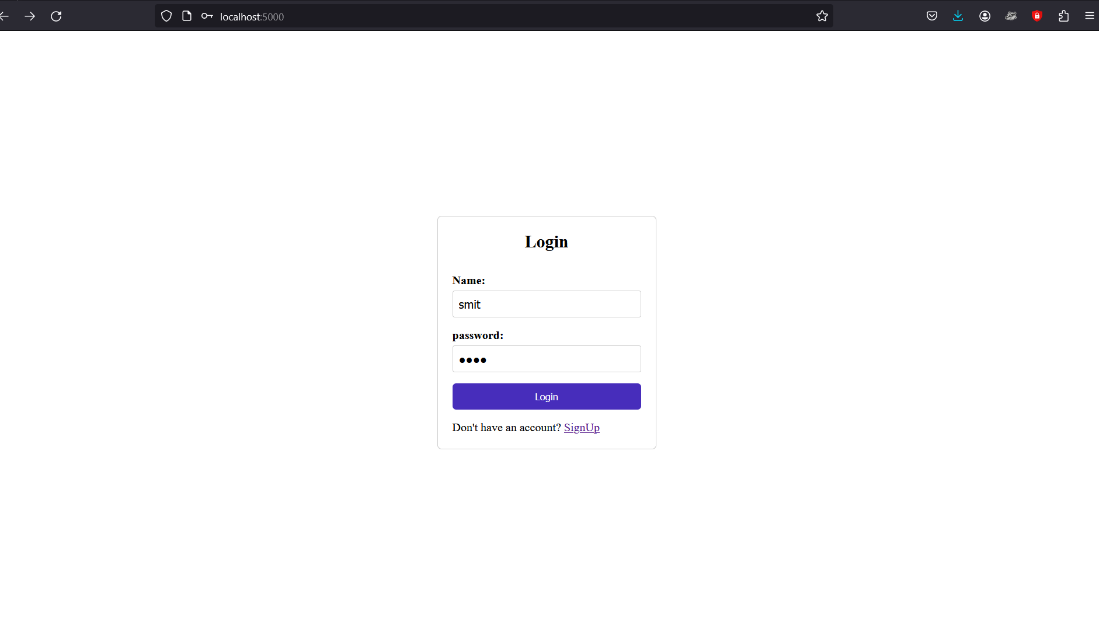
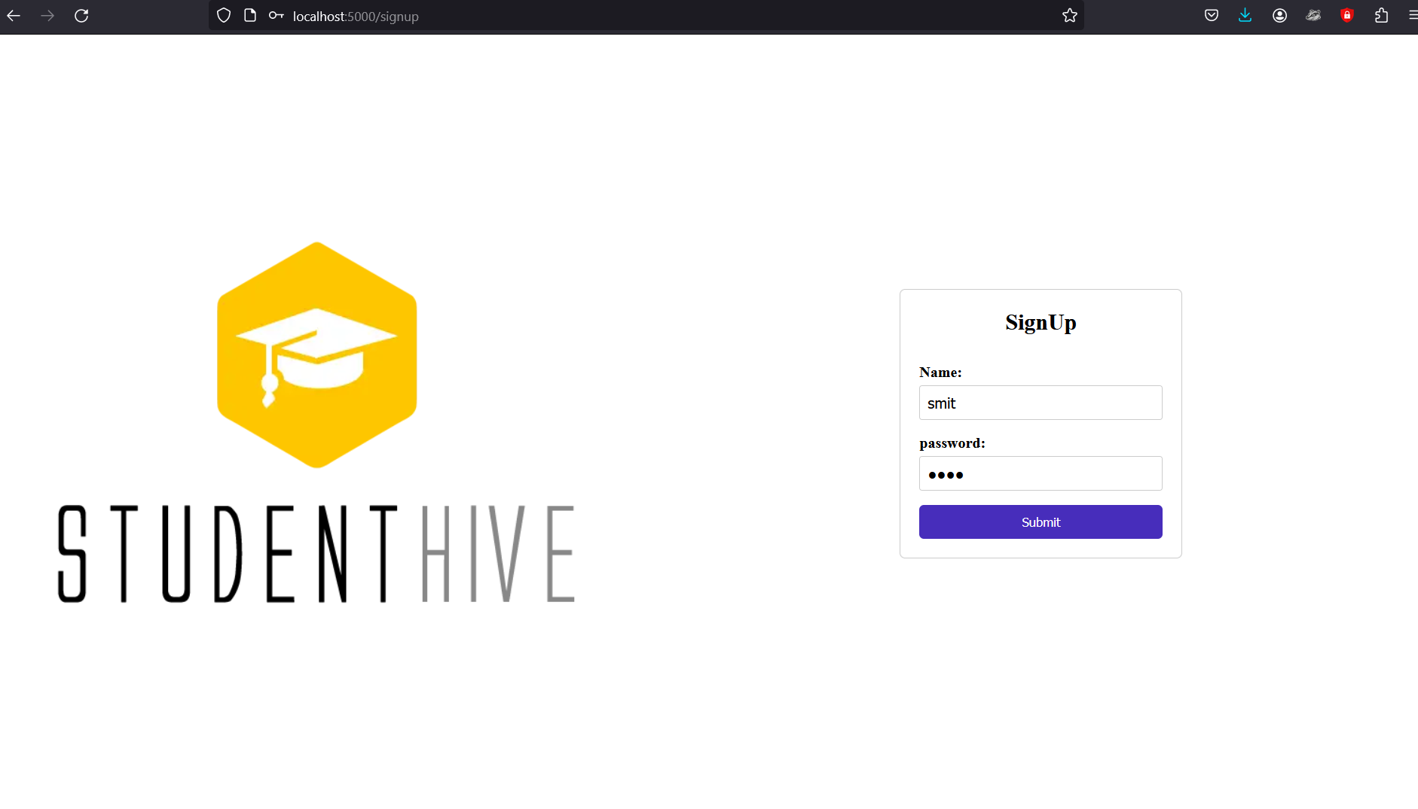
Project demo screenshots

Slide 30
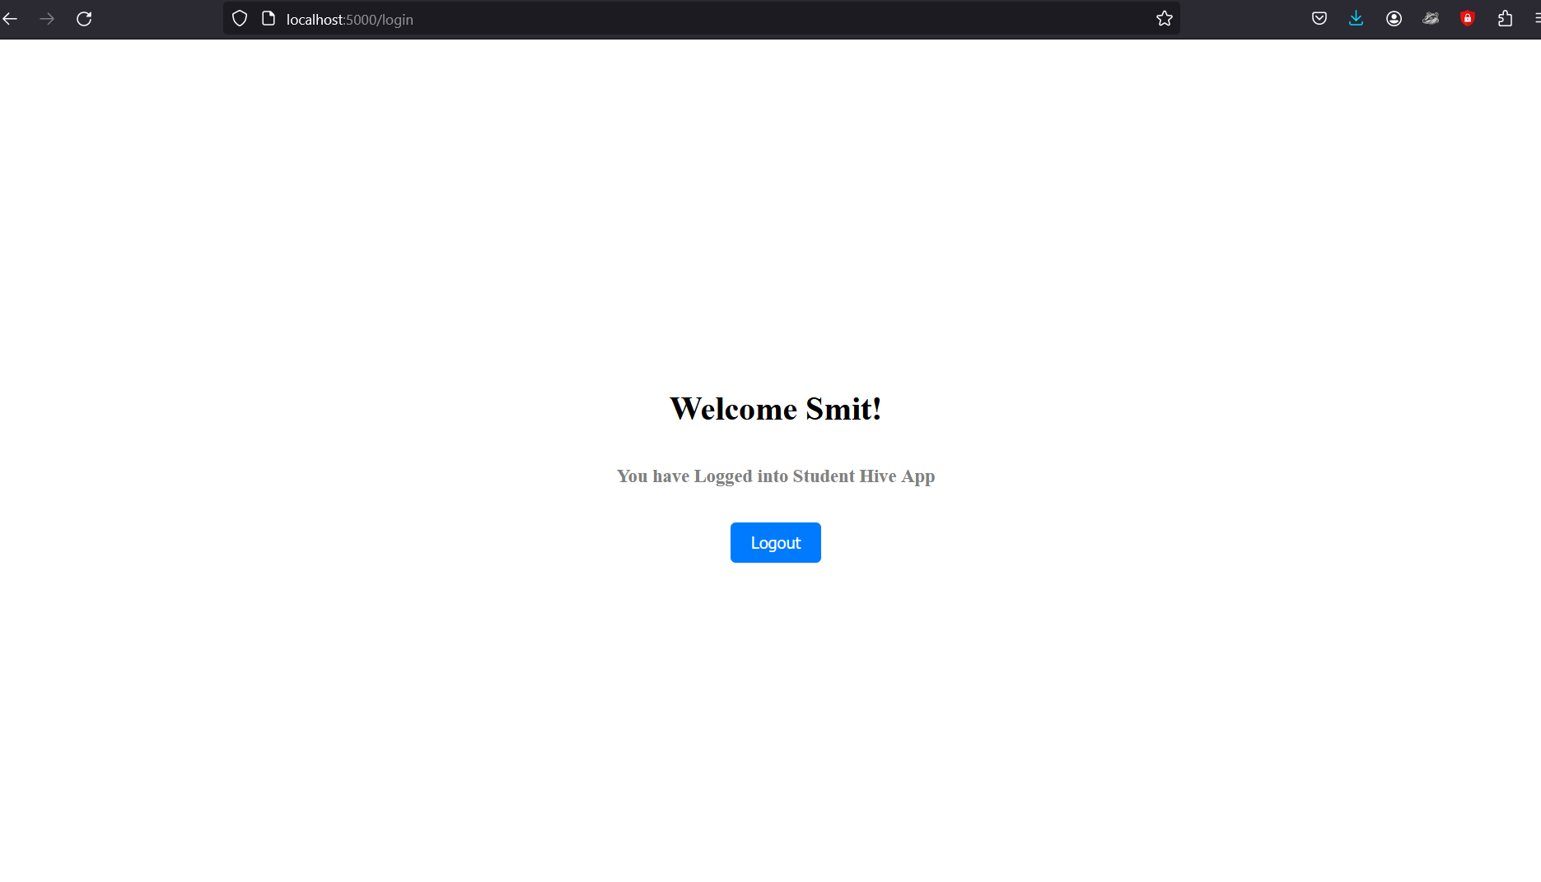

Slide 31
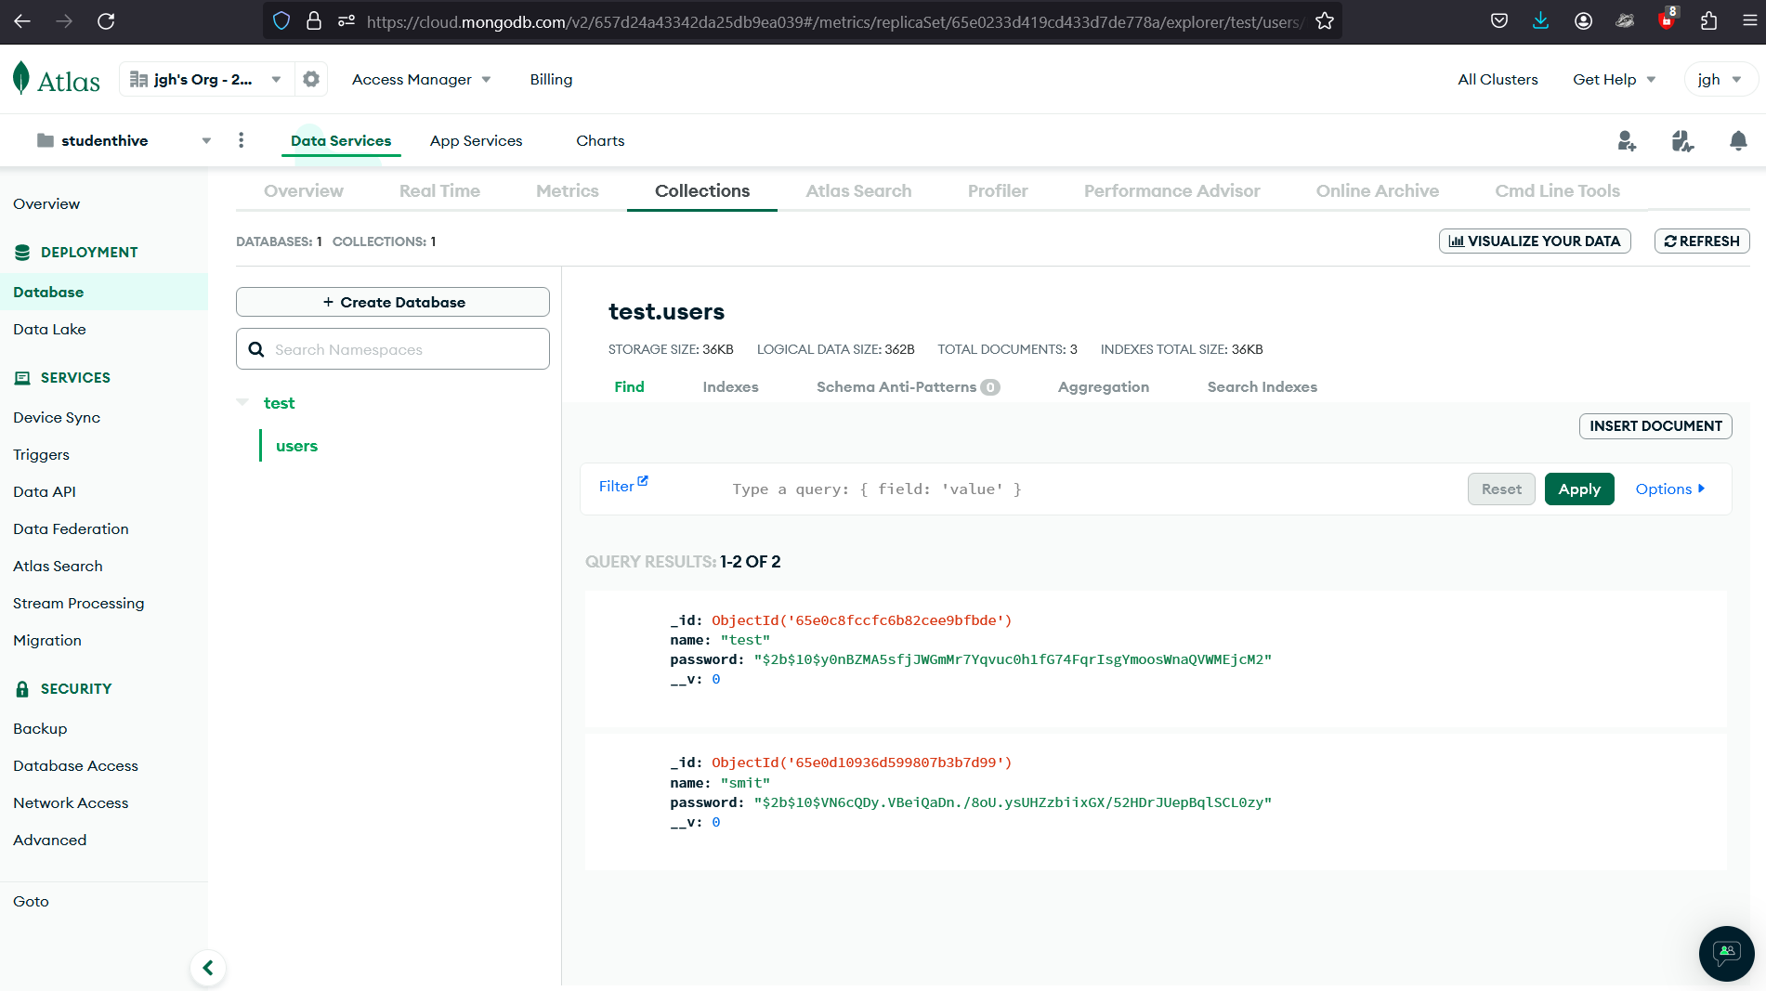
Project demo database screenshots

Slide 32
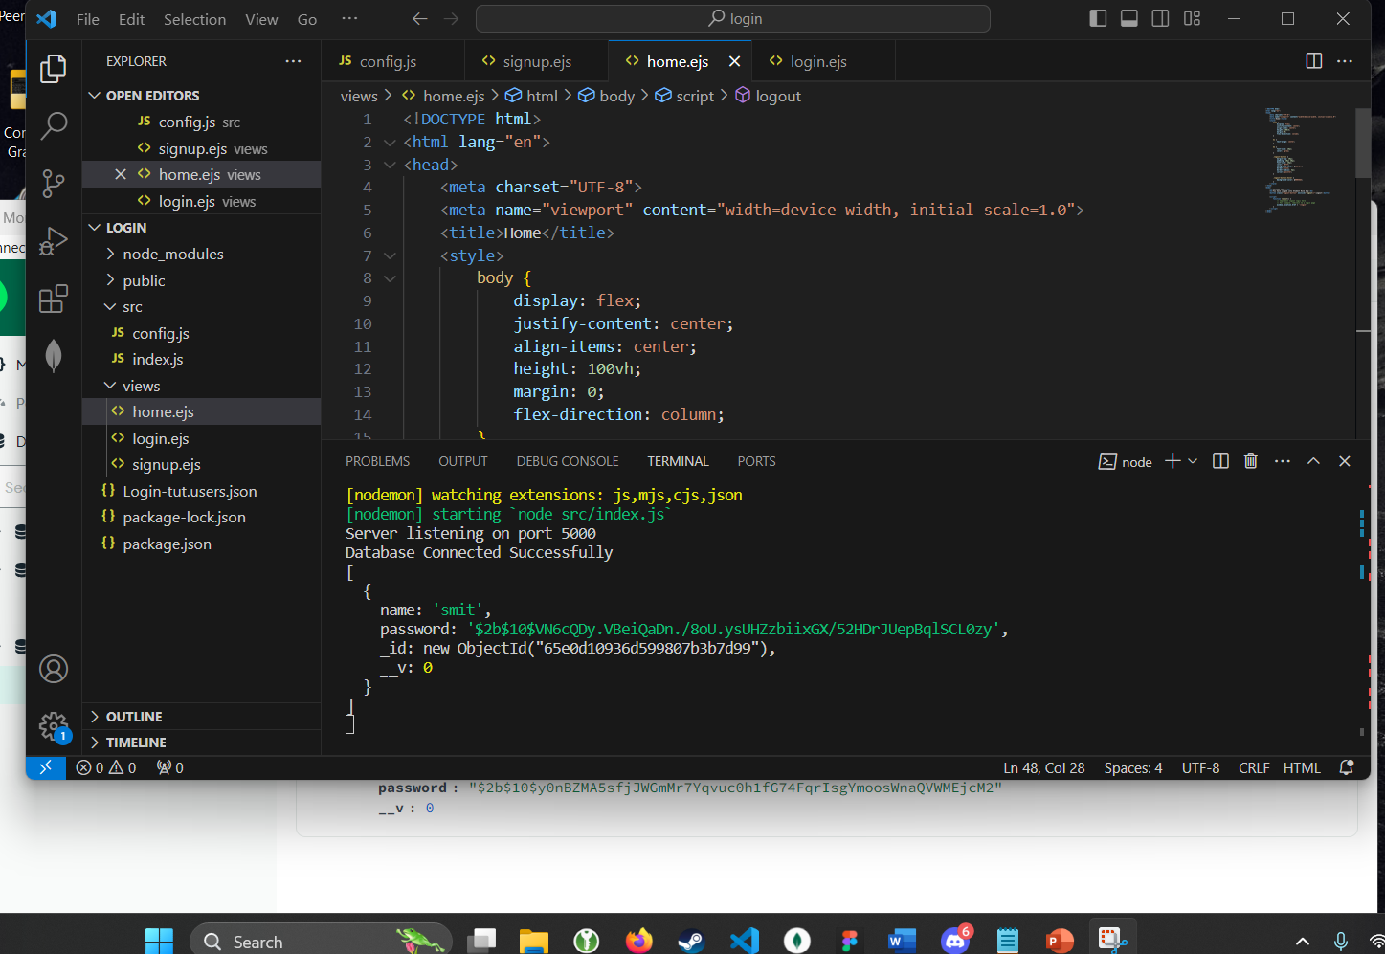
Live demo project

Slide 33
WIKIPAGE LINK
https://github.com/rajkoushikv/studenthive/wiki/Wikipage

Slide 34
THANK YOU

